Slide 1
Aviation dataset
Jet Analysis

Slide 2
Embarking on a high-flying adventure in the world of aviation! As we venture into the aviation industry it’s crucial to understand the landscape of airline safety. We’re conducting an in depth analysis of aircraft accidents. This will guide our strategic decisions ensuring safety remains our top priority as we expand into this new domain.

Slide 3
Analysis Method Narrowed down to the following 10 manufacturers from 89,000 NTSB accident records:
Boeing
Airbus
Bombardier
Embraer
Dassault
Gulfstream
Cessn
a Pilatus
Hawker
Mitsubish

Slide 4
Measurements of Safety
Average fatal, minor and serious injuries
Uninjured rate
Fatality Rate
Number of occurences of incidences/accidents

Slide 5
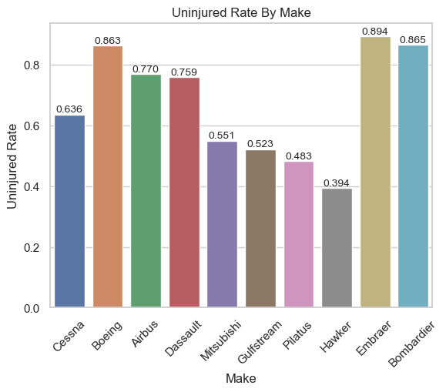

Slide 6
FINDINGS

Slide 7
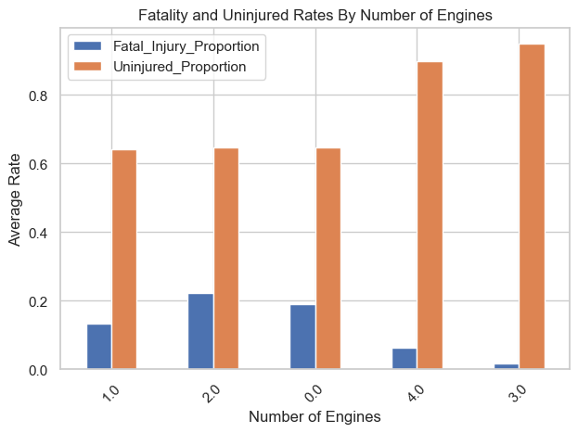

Slide 8
Recommendations
Embraer - Commercial Division
Bombardier CL-600 - Private Division

